Slide 1



Changemakers Social Challenge CSC 2025
IOS DEVELOPEMENT LAB
FACULTAD DE INGENIERIA
PRESENTED BY :
IOS TEAM

Slide 2





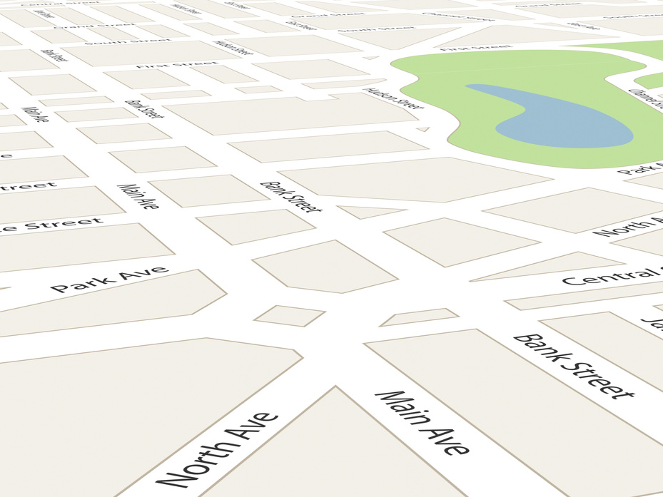
TIME T
IMAGINE...
BRANDING
PROJECT

Slide 3


Slide 4



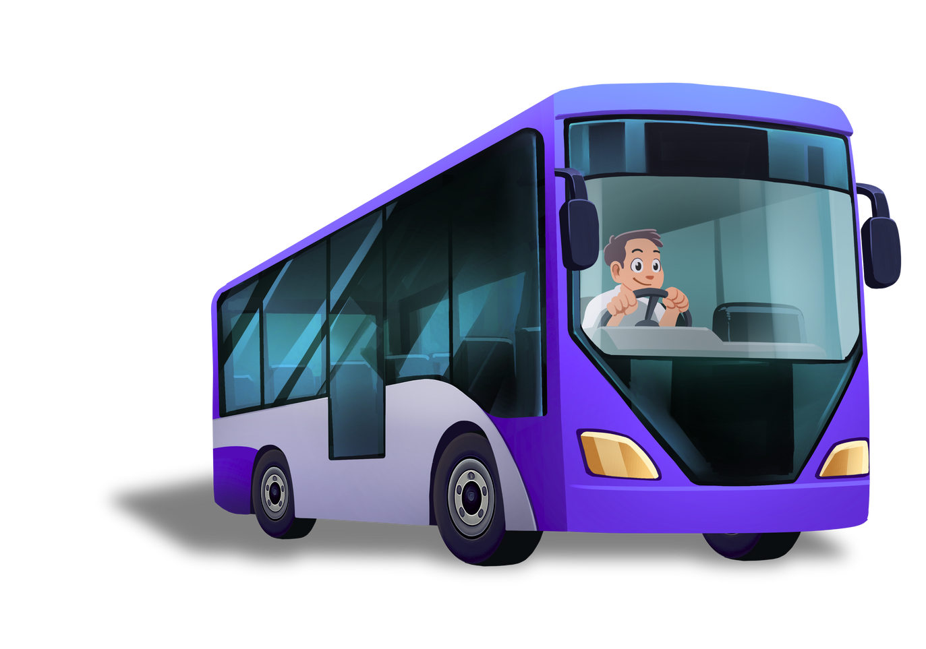
PROBLEM
Logistical chaos
Mobility issues
A broken and fragmented experience

Slide 5

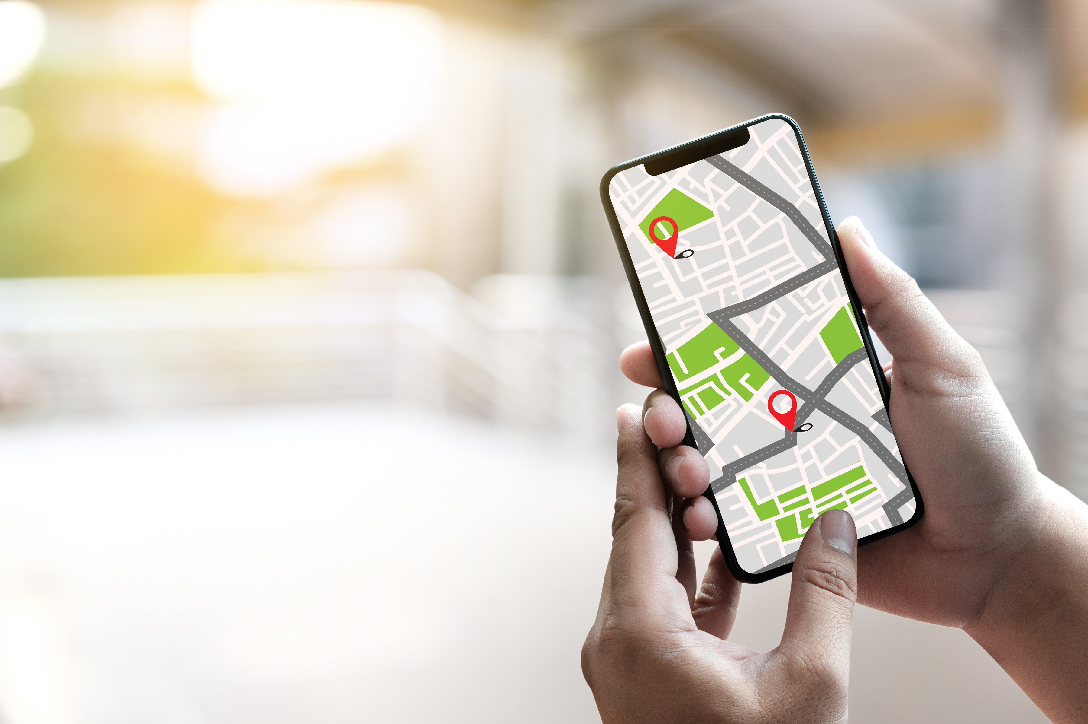
OUR
SOLUTION

Slide 6


INTRODUCING
ATENEA

Slide 7
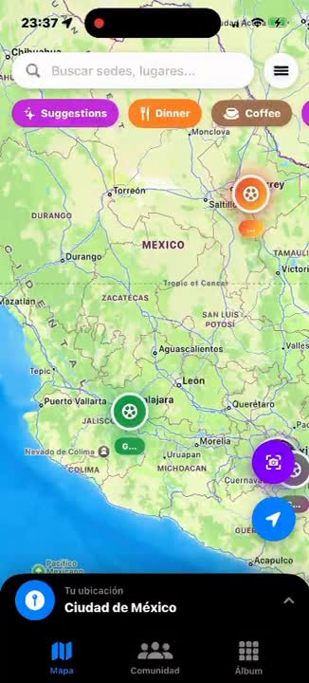

ATENEA
The ultimate companion for the 2026 World Cup.

Slide 8




WE ARE DIFFERENT
01
02
03
04
INTERACTIVE MAP SCREENSHOT
CHAT WITH AI SCREENSHOT
PANINI ALBUM AR IMAGE
SOCIAL NETWORK

Slide 9

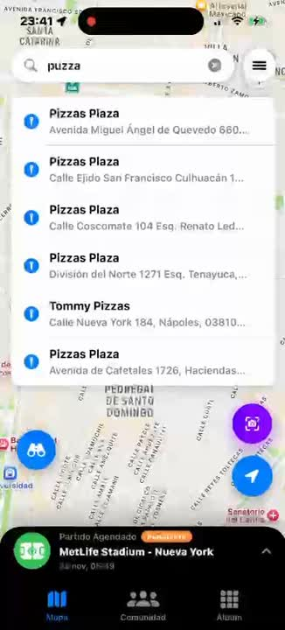


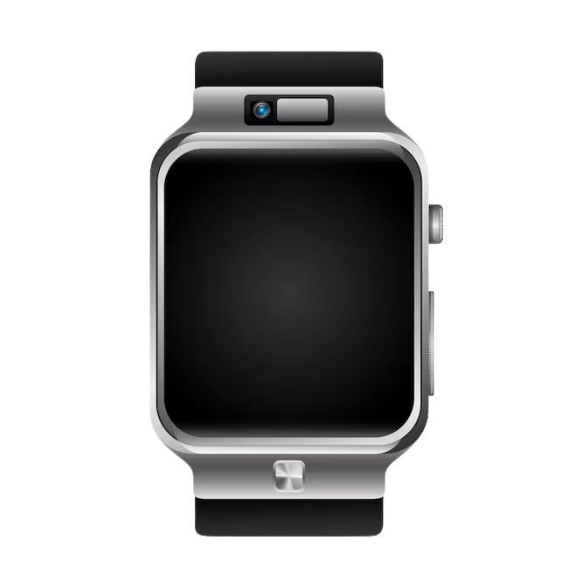
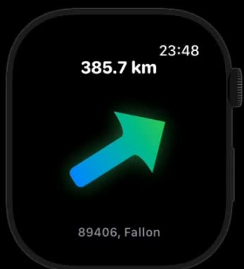
INTERACTIVE MAP
Our interactive map shows the 16 venues and provides real-time routes, with navigation on your lock screen. Getting to the match has never been easier

Slide 10



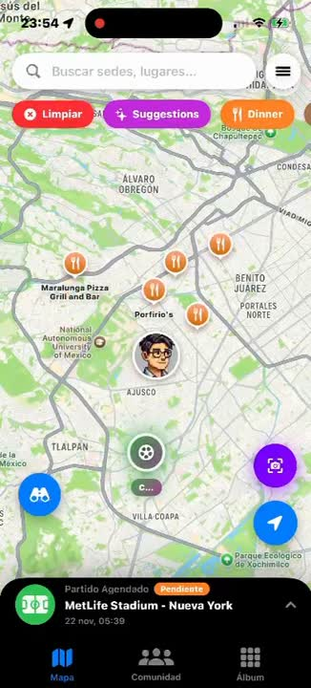
DISCOVER
WITH IA
Our AI recommendation engine becomes your local expert. Just ask ATENEA, 'Find the best tacos near Estadio Azteca,' and get instant, personalized answers.

Slide 11

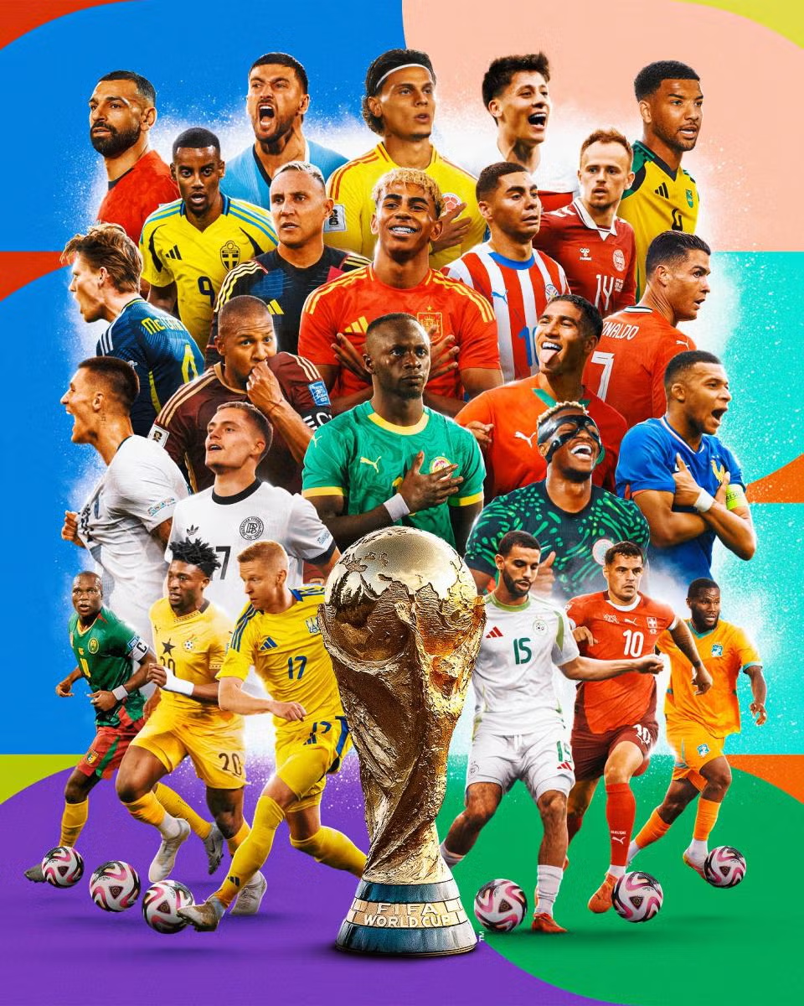

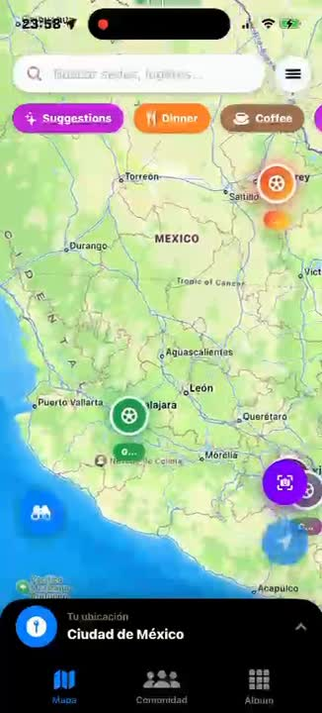
AUGMENTED
REALITY ALBUM
Scan physical cards to unlock digital versions, collect legendary stickers, and even view 3D stadiums on their table

Slide 12


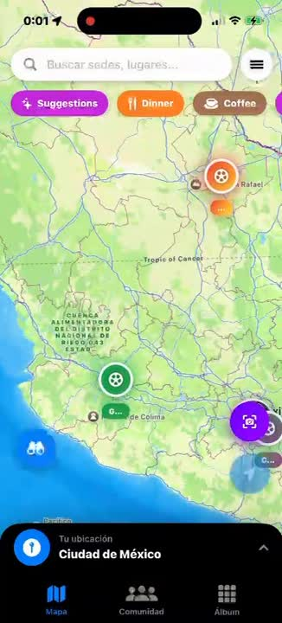
PANINI ALBUM
IS BACK
Scan physical cards to unlock digital versions, collect legendary stickers, and even view 3D stadiums on their table

Slide 13
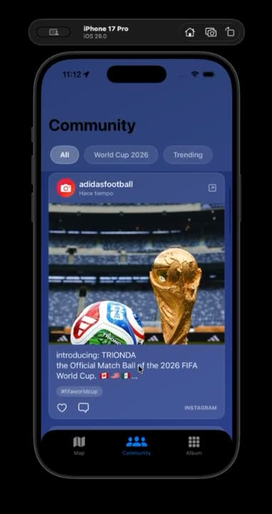

Our integrated social network allows fans to share discoveries, trade stickers, and connect with others in the same city
CONNECT
SHARE ,
ENJOY

Slide 14
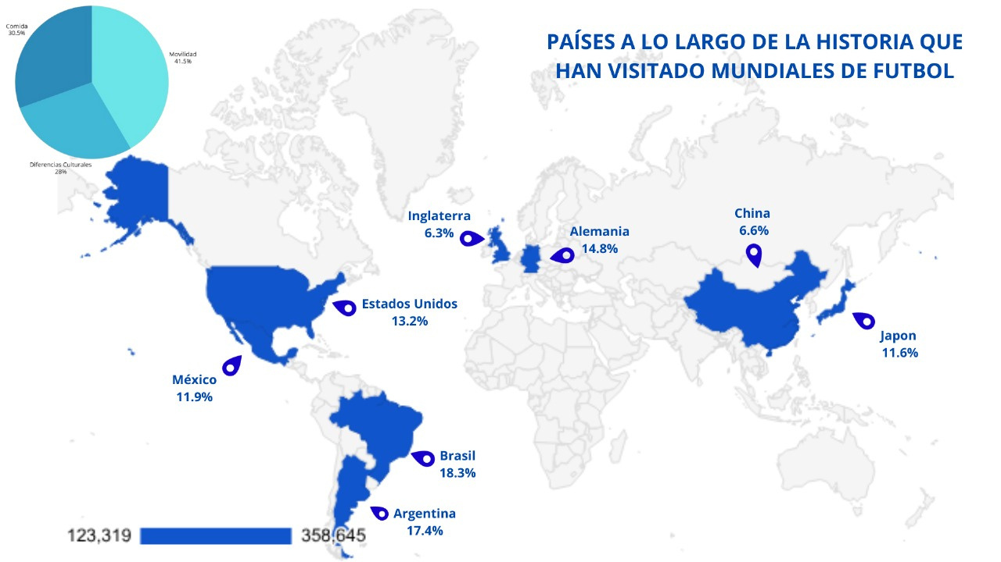
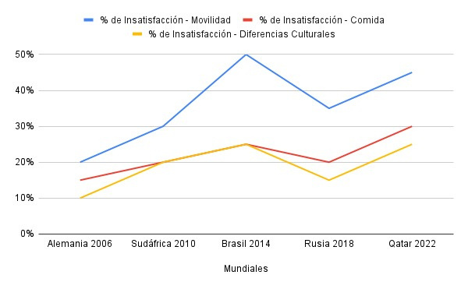

Slide 15


ATENEA: TU SABIDURÍA PARA EL MUNDIAL 2026
While other map apps lack the soul of a true fan, sticker apps won’t get you to the stadium, and social networks don’t understand what an offside is… Atenea brings it all together

